Slide 1
Week 6 Presentation
MSA 8030 Communicating with Data - Team 5
Tyler Trocchi, Jared Jones, Jasmine Weekes
December 3, 2024

Slide 2

Sales Pitch Recap
Business Objective: To minimize delays and predict cancellations through analytics to help Delta Air Lines remain the #1 rated airline
Dataset: 7,213,446 flights
Rows of data from Delta: 949,283 flights, about 13% of the data
Model Selection: Neural Network

Slide 3
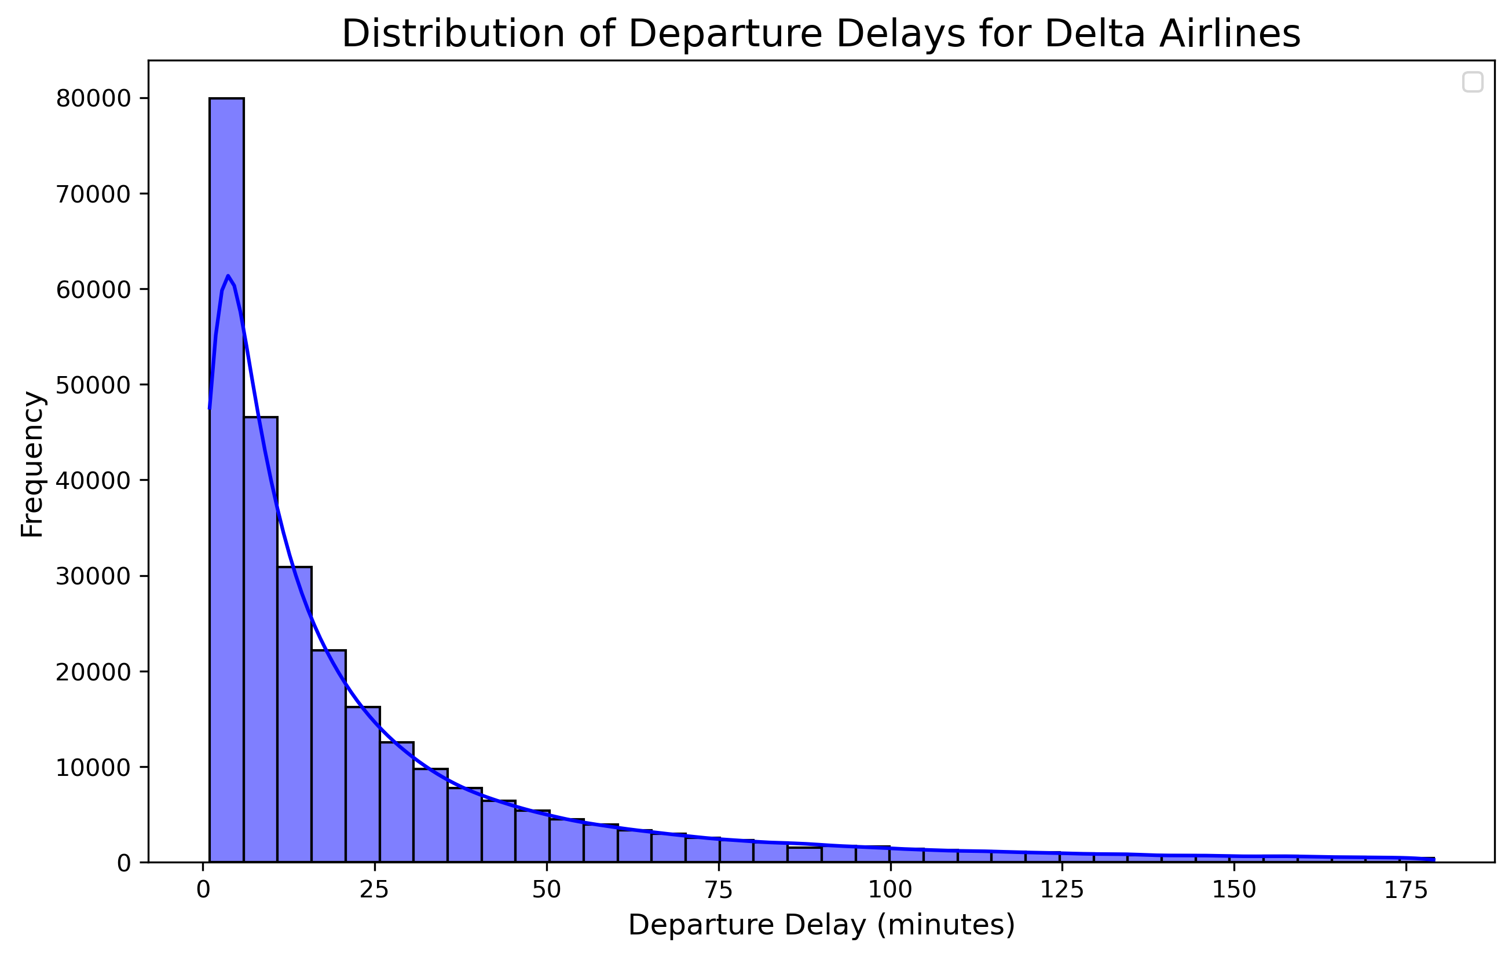
Problem Scope Data
Number of Delta flights delayed: 286,165 flights, over 30% of Delta flights
Average delay time: 33.6 minutes
Total delay time: 9,607,036 minutes
Longest delay time: Over 20 hours
Even a small delay costs Delta money due to operational costs such as fuel, extra staffing and aircraft maintenance

Slide 4
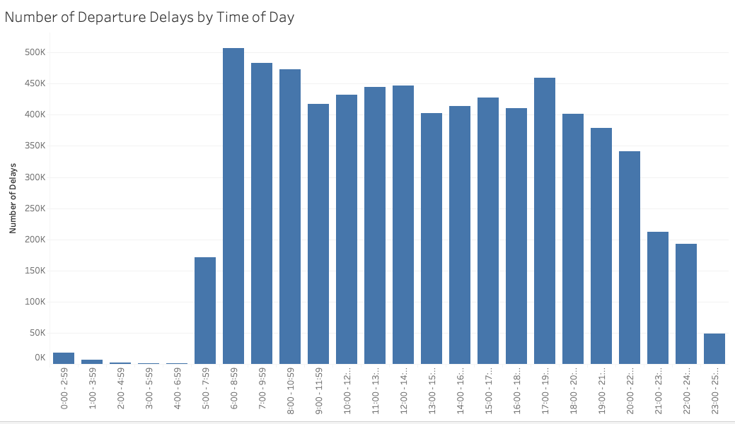
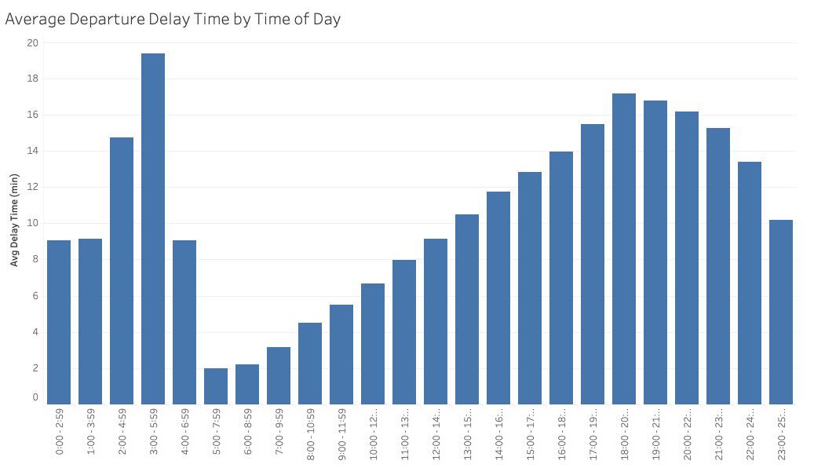

Flight Time Impact
Identifying peak delay times
More accurate departure forecasting and improved operational efficiency during critical hours
Assess improvements in maintenance and operational protocols
Understanding when delays are typically longer
Better communication with passengers about expected departure times
Potentially smoother operations with fewer last-minute disruptions

Slide 5
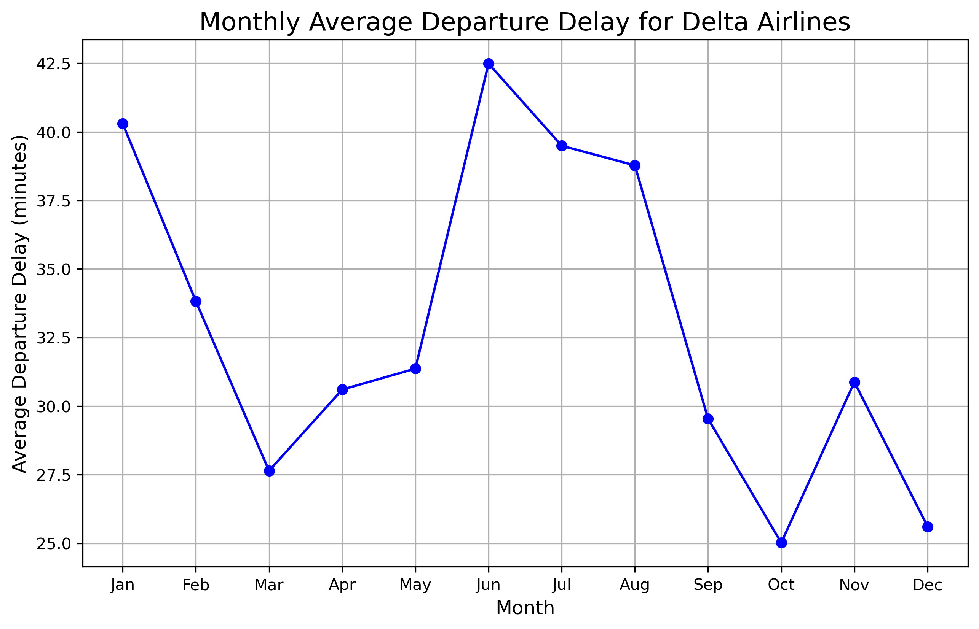
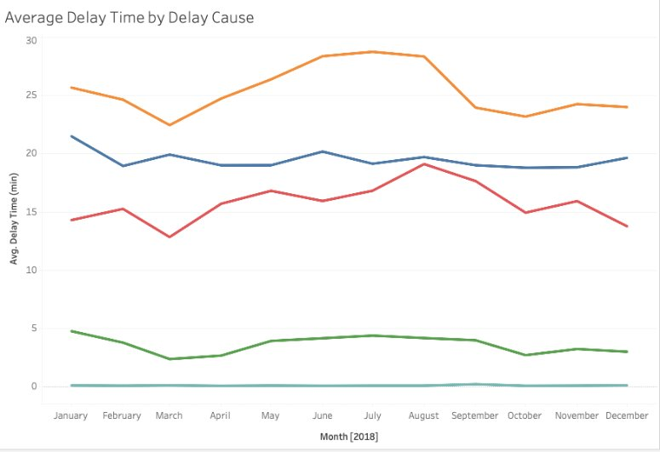
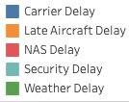
Seasonality
Using yearly patterns throughout the year to anticipate delays/cancellations better.
Delays peak in the summer and beginning of the year.
Even the lowest average delay is over 25 minutes.
Enables targeted interventions for factors within airline's control and better preparation for those outside of its control.
Weather-related delays slightly increase during the winter months and mid-summer, likely due to seasonal storms
Carrier and late aircraft delays show fluctuations but maintain a consistent presence throughout the year.

Slide 6


Our Solution
Our departure forecasting model will allow Delta Air Lines to:
Reduce frequency and duration of flight delays
Improve customer satisfaction
Adjust airline and staffing resources
Optimize and streamline resource management
Anticipate flight delays and causes
Communicate accurate departure times
Remain the #1 preferred airline in the U.S.

Slide 7
Thank you

